Slide 1
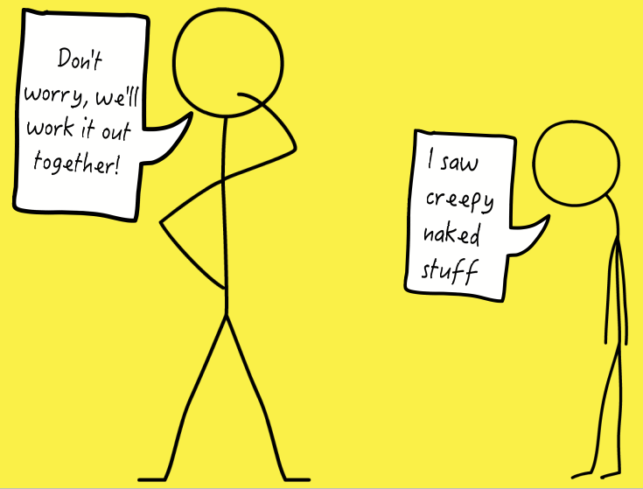
A Parent’s Guide to Talking about Pornography

Slide 2
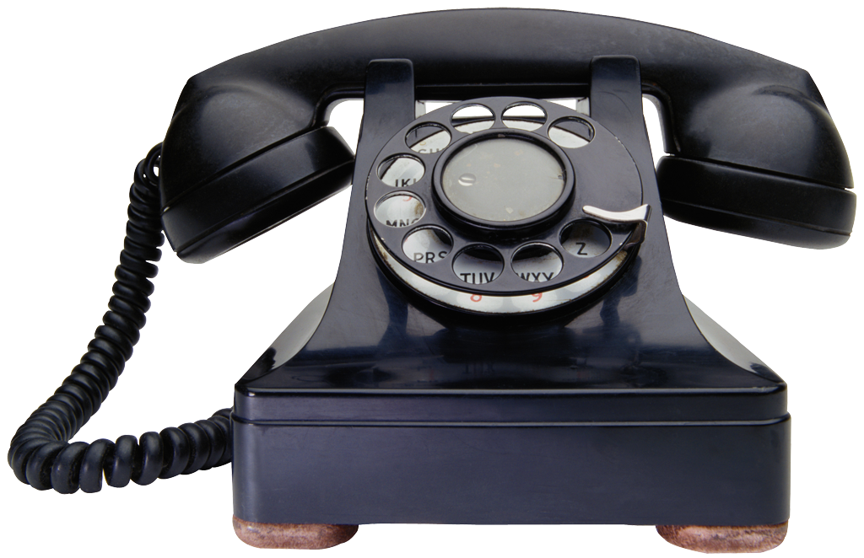
Technology
The technological age can leave parents ill-equipped to understand or recognise the ways in which technology are negatively affecting our children. Security settings, internet sites and social media can seem alien to those of us who grew up with access to only a landline phone and perhaps dial up internet, both under the control of our parents.

Slide 3
Indecent Exposure
Children and young people are accessing the online space at a younger and younger age, and are being exposed to content that as parents, we never discovered until we were a lot older.

Slide 4
Online Pornography
Some parents have never viewed online pornography are so are unaware that the majority includes:
^{Men ejaculating on women}
Multiple men penetrating one woman
^{Anal sex}
^{Sexual violence}
^{Racism}
Language which degrades and dehumanises women

Slide 5
Online Pornography
Online pornography almost never includes:
^{People wearing clothing}
^{Intimacy}
^{Respect for women}
^{Love/care}
^{Acting}
It is women being penetrated by men and objects; vaginally, orally and anally, usually in a violent manner.

Slide 6
How many children are affected?
“39% of boys in England aged 14-17 admitted they regularly watched pornography.”
“ChildLine currently receive an average of 18,000 views a year to its website message board threads with porn in the subject heading.”

Slide 7
How are children affected?
Stories of children googling words they hear in school are commonplace. Searching “sex” or “porno” after hearing their friends or others talking about it, can lead to children younger than 8 years old viewing graphic images and videos of hardcore pornography.

Slide 8
How are children affected?
The full impact of pornography on children and young people will be seen over the next few generations, but we do know that:
72% of girls will be emotionally abused by a boyfriend by the age of 16.
By the age of 16, 40% of girls have been pressured into sexual activity.

Slide 9
How are children affected?
"I'm always watching porn and some of it is quite aggressive. I didn't think it was affecting me at first but I've started to view girls a bit differently recently and it's making me worried. I would like to get married in the future but I'm scared it might never happen if I carry on thinking about girls the way I do.”
12-15 year old boy

Slide 10
How do we respond?
As parents we can feel:
Unconfident
Worried
Fearful
About talking about pornography with our children.

Slide 11
How do we respond?
We may want to keep our children innocent for as long as possible or believe that our children will simply not be affected. Often by the time we have conversations, it is too late. Our children have already been exposed to images or videos online.

Slide 12
Having conversations
It is possible to have conversations with our children about pornography and the issues related to it, without destroying our their innocence.

Slide 13
Proactive Conversations
If we have proactive conversations about pornography with our children we…
Give them a safe framework for when they are exposed to images/video
^{Prevent shock and trauma}
Show them no subject is off limits
Enable them to feel more confident about saying no

Slide 14
Key Messages
^{Nakedness isn’t bad}
^{Sex can be good, for grown ups}
There’s lots of images around with women being made to look “sexy” (e.g. Page 3, music videos, adverts)
There’s naked stuff and sex stuff online that isn’t very nice
You might not understand it and might feel bad when you see it
You might find it by accident or someone might show you it
If you see anything that makes you uncomfortable, it’s really important to tell a grown up

Slide 15
How to start the conversation
Chess pawn/Pawn Shop/Porn
When talking about words that sound the same, but have different meanings, bring up the word “pawn”. Talk about the different meanings of the word as a lead in to talking about pornography.

Slide 16
How to start the conversation
Bathtime
When it’s bath time or bedtime, talk about nakedness and how great bodies are. That underneath our clothes we’re all naked. Explain that although nakedness is good, we might see pictures or videos online where there’s naked people who aren’t being very kind.

Slide 17
How to start the conversation
Phone/Tablet/Laptop Rules
When your child is old enough to have access to their own technology, sit down together and make rules about how/when to use it. Explain that there may be things they see online that aren’t safe and use this as a lead in to talk about pornography, alongside other online risks.

Slide 18
How to start the conversation
“Creepy Online Stuff” video
Play the “Creepy Online Stuff” video to your children and use it to begin conversation about online pornography.
https://youtu.be/g_HMSRA_-OE

Slide 19
We can’t prevent our children seeing images and videos of pornography, but we can work towards preventing pornography harming our children.

Slide 20
For further details
Website: www.dayprogramme.org
Email: info@dayprogramme.org
Twitter: @dayprogramme

